Slide 1
BIG DATA
Building data pipelines

Slide 2
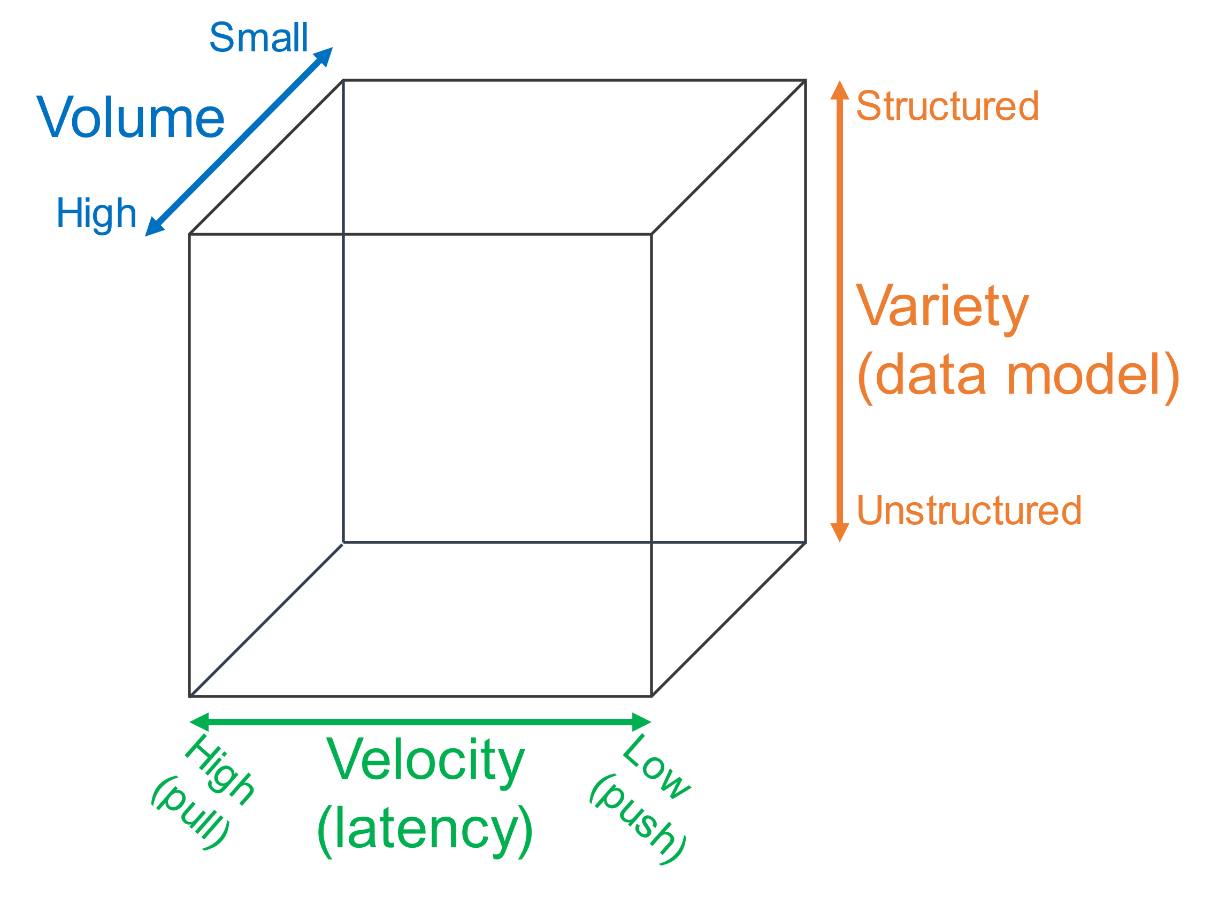
Reference scenario
The big-data cube
Volume: small to high
Variety: structure to unstructured
Velocity: pull to push
Meijer, Erik. "Your mouse is a database." Communications of the ACM 55.5 (2012): 66-73.

Slide 3
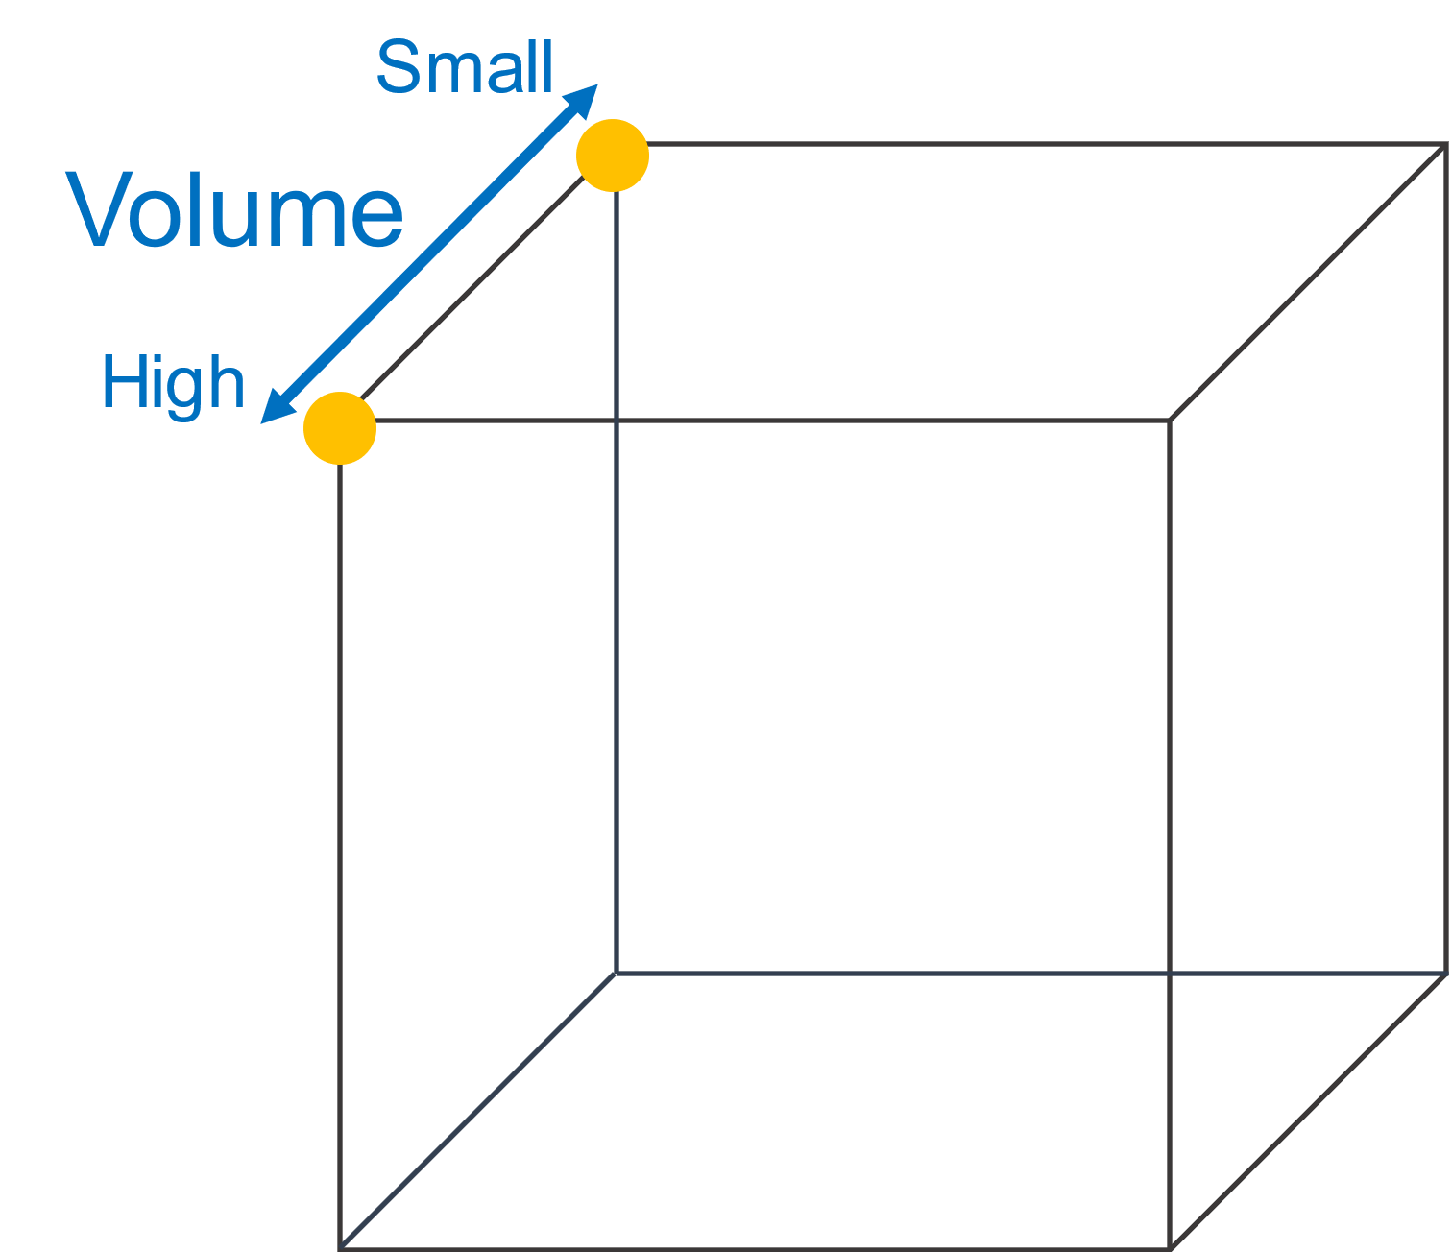
Reference scenario
Volume
Small: small relational DBs
High: TBs o PBs of data

Slide 4
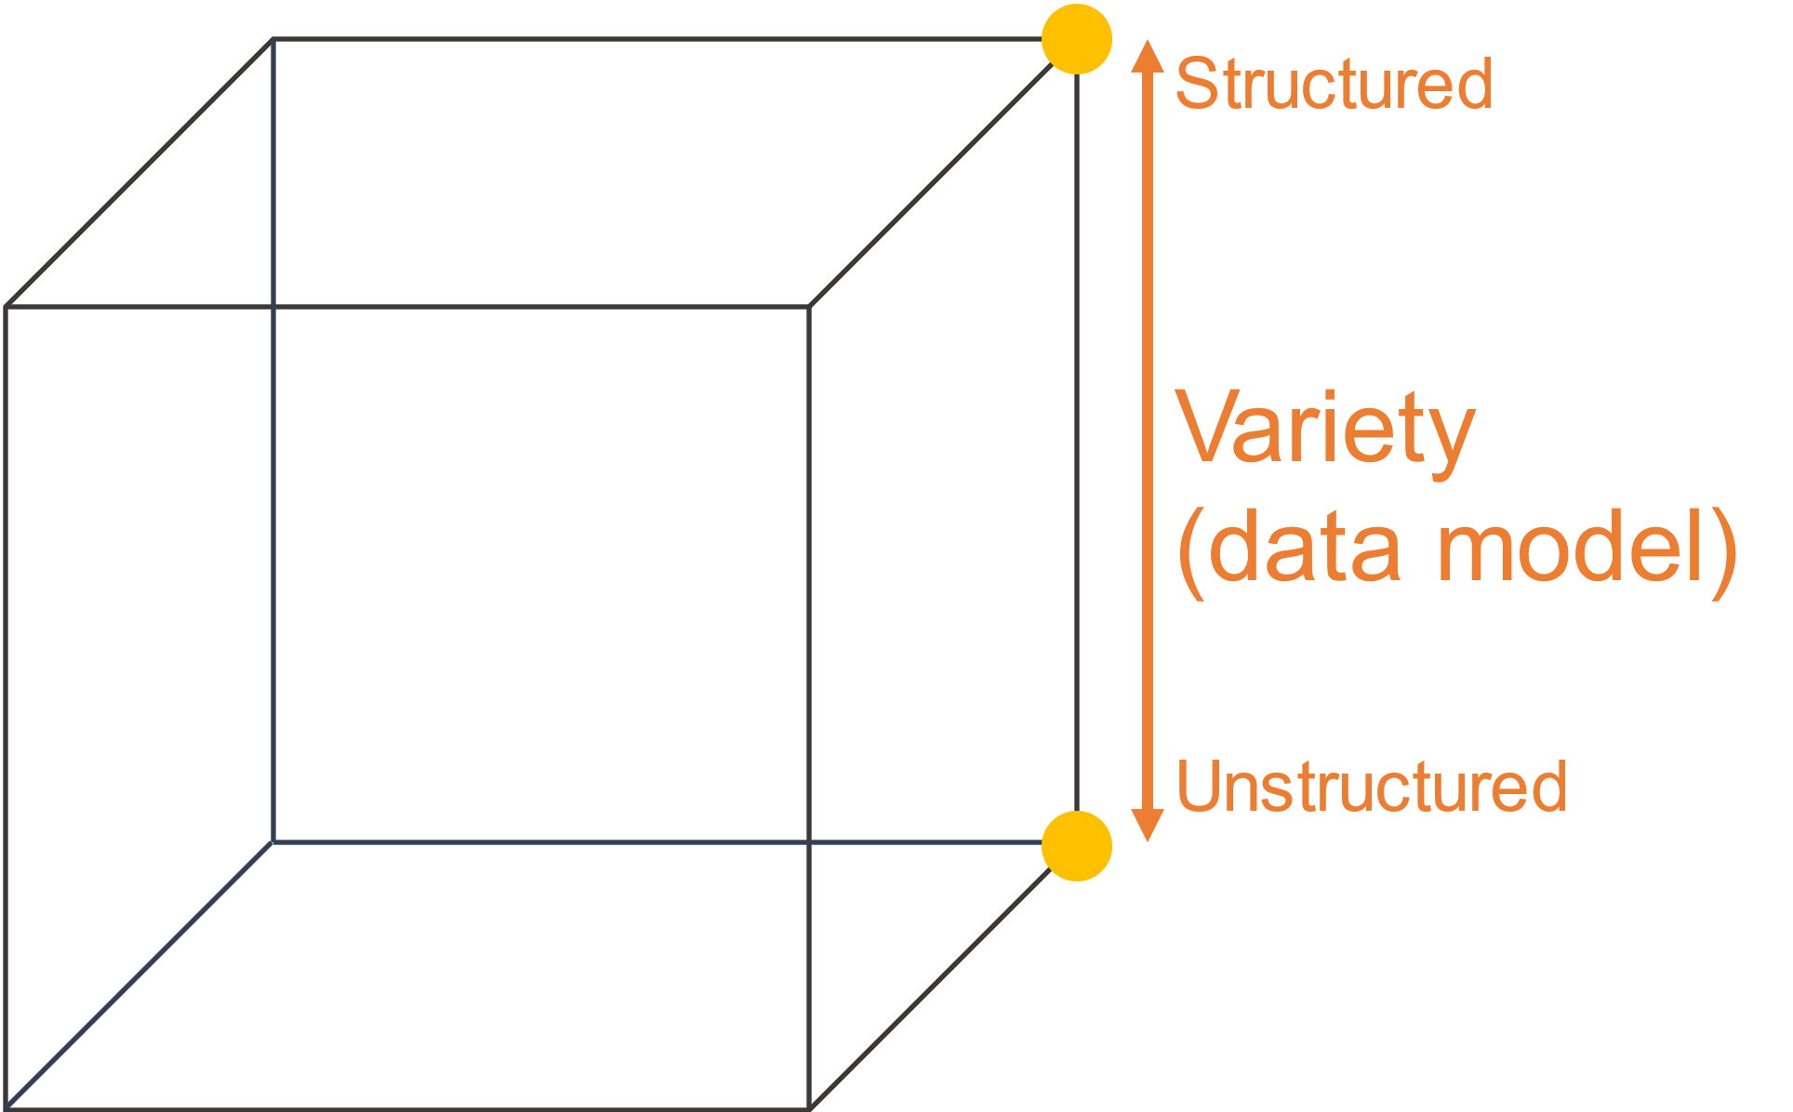
Reference scenario
Variety
Structured: relational tuples with
FK/PK relationships
Unstructured
Key-value
Columnar
Document-based
Graph
...

Slide 5
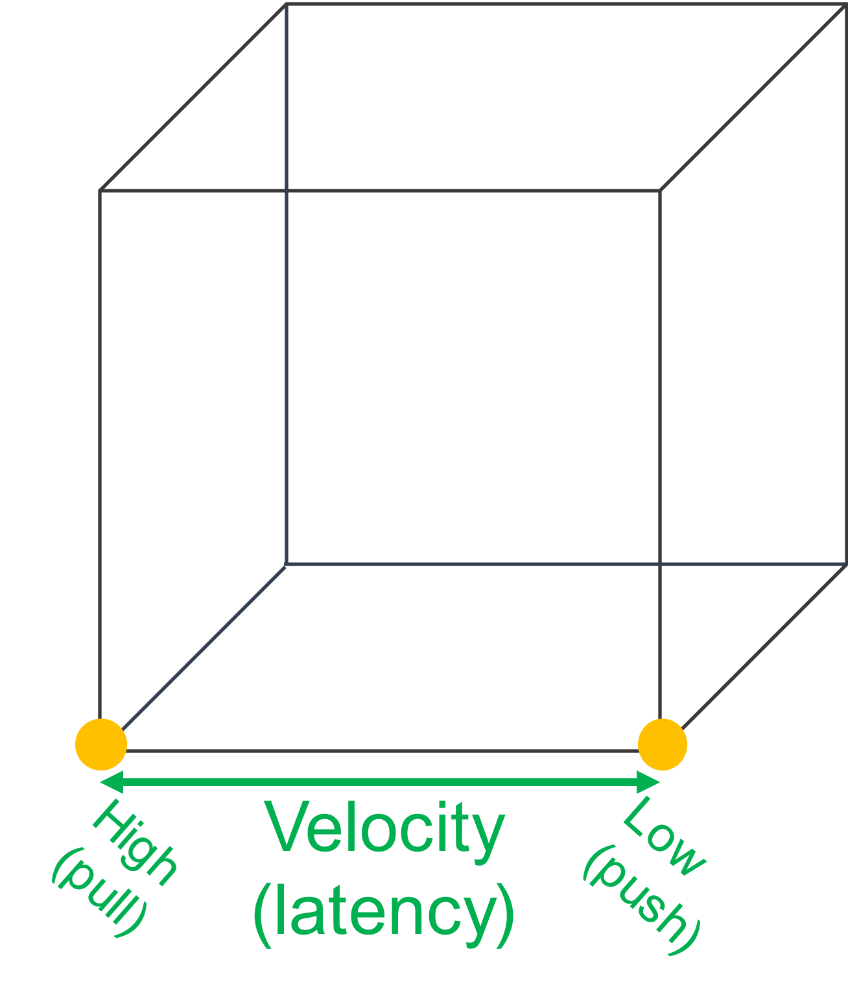
Reference scenario
Velocity (latency)
High: clients synchronously pulling data from sources
Low: sources asynchronously pushing data to clients

Slide 6
Reference scenario
Our focus
(Un)Structured big-data batch
(Un)Structured big-data streams
Goal: keep in mind the cube to
categorize the services
Small
Volume
Structured
High
Variety
(data model)
Batch
Stream
Unstructured
High
Velocity
Low
(pull)
(
(
push
latency
)
)

Slide 7
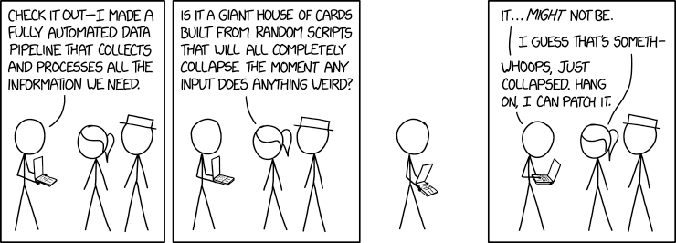
Data pipeline
Data pipeline
"A succession of operations to transform and consume raw data"
https://xkcd.com/2054/
Quemy, Alexandre. "Data Pipeline Selection and Optimization." DOLAP. 2019.

Slide 8
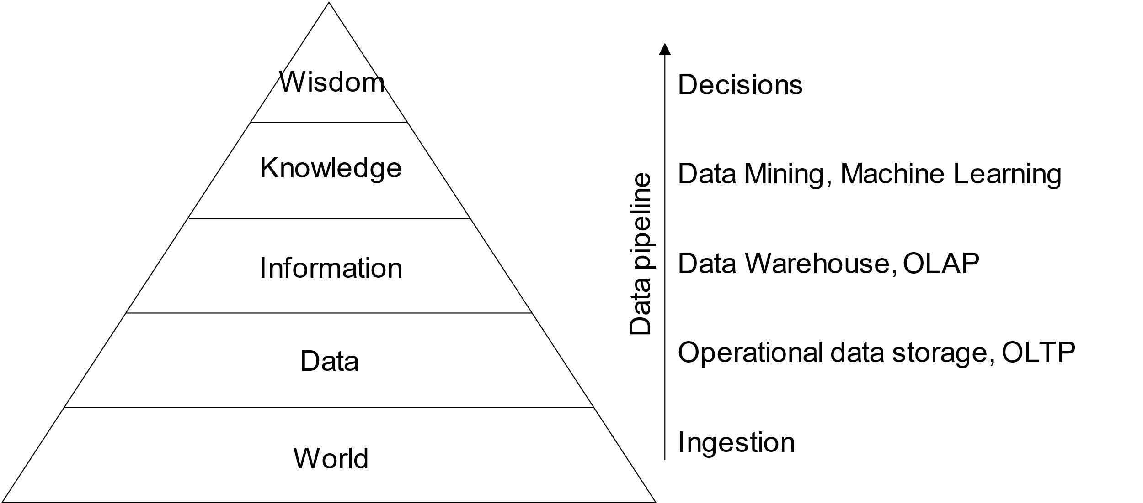
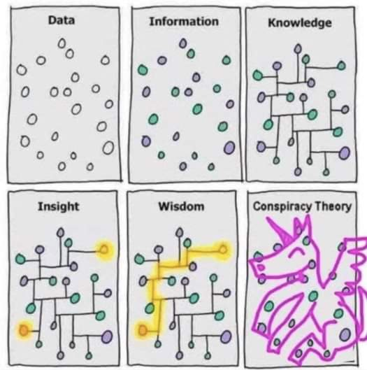
Data pipeline
DIKW hierarchy
Layers representing structural relationships between data, information, knowledge, and wisdom
Ackoff, Russell L. "From data to wisdom." Journal of applied systems analysis 16.1 (1989): 3-9.

Slide 9
Date pipelines on cloud
The pyramid abstracts tons of techniques, algorithms, etc.
To provide them as services, architecting data pipelines on cloud requires
Standardization (of common services)
Integration
Orchestration
Accessibility through simple APIs
Let us look to data pipelines on different cloud services providers

Slide 10
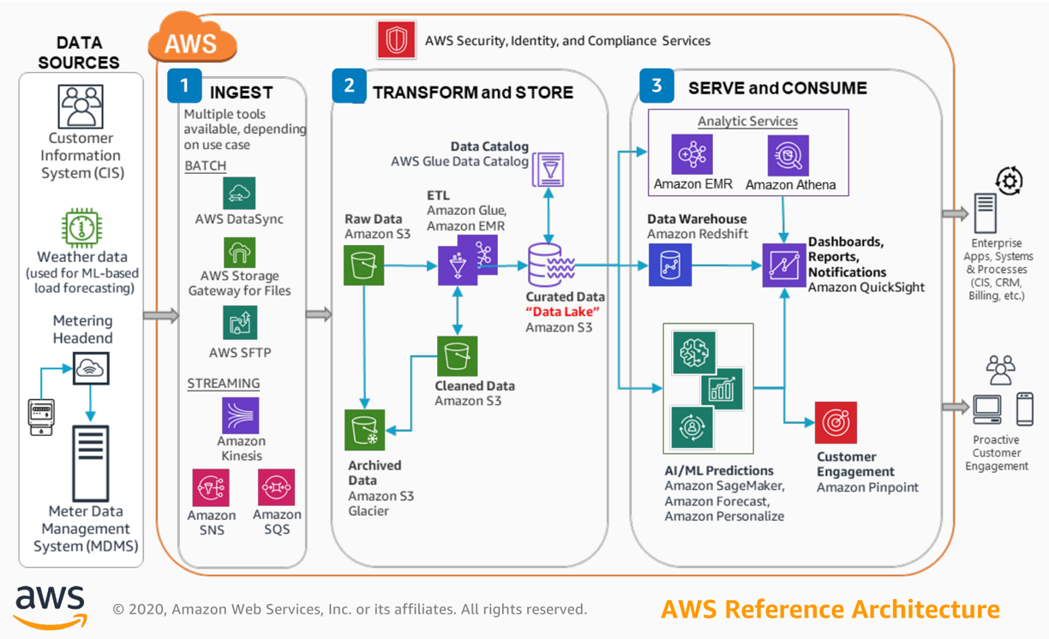
Data pipeline - AWS
Three main categories
Ingest
Gateway, DataSync (batch)
Kinesis, SNS, SQS (stream)
Transform and store
S3 and Glacier (storage)
Glue (ETL)
Serve and consume
EMR (Hadoop-like cluster)
Athena (serverless query service to analyze data in Amazon S3)
(Many) Machine learning services
https://console.aws.amazon.com/console

Slide 11
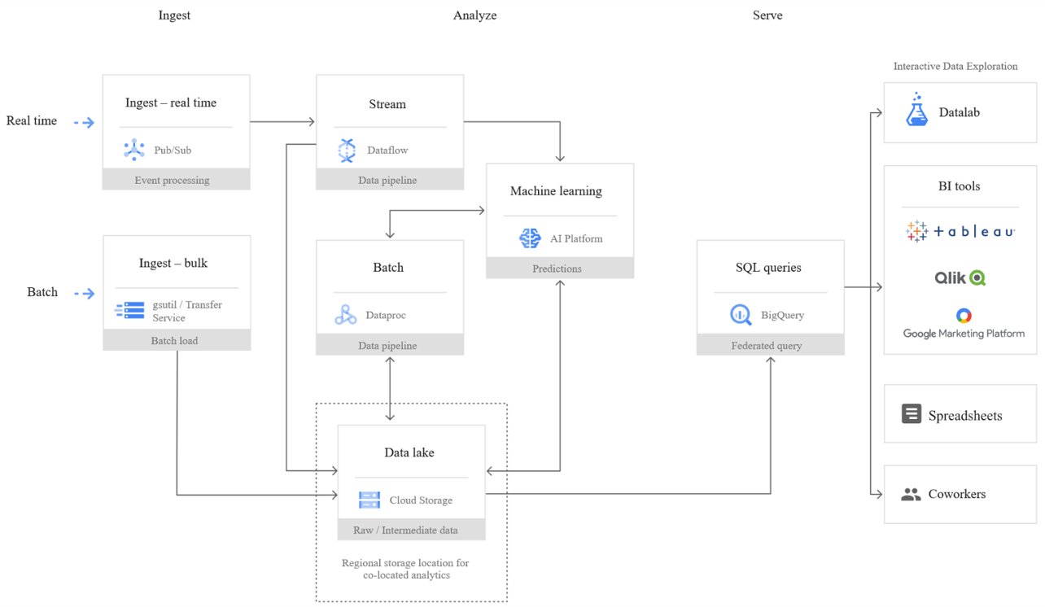
Data pipeline - Google cloud
Three main categories
Ingest
Transfer service (batch)
Pub/Sub (stream)
Analyze
Dataproc (batch)
Dataflow (stream)
Cloud storage (storage)
Machine learning services
Serve
BigQuery (query service)

Slide 12
A tentative organization
Common points
We have services
Which transforms data
Recall the DIKW pyramid
Which supports data transformation
Data pipelines are based on
Ingesting data
Analyzing data
Serving data
Data
transformation
Supporting services
Serve (deciding)
•
SQL
•
BI tools (e.g., Tableau)
Analytics (analyzing)
Storage
•
Processing
(organizing)
Security
•
File
•
Access Control
Networking, etc.
•
Batch
•
Authorization
Computing
•
Streaming
•
Object
•
Machine learning
•
DB
Ingestion (acquiring)
•
Batch
•
Streaming

Slide 13
A tentative organization
This is not a sharp taxonomy
Ingestion vs Analytics
Data streams are used for ingestion
... and (event) processing
Data
transformation
Supporting services
Serve (deciding)
•
SQL
•
BI tools (e.g., Tableau)
Analytics (analyzing)
Storage
•
Processing
(organizing)
Security
•
File
•
Access Control
Networking, etc.
•
Batch
•
Authorization
Computing
•
Streaming
•
Object
•
Machine learning
•
DB
Ingestion (acquiring)
•
Batch
•
Streaming

Slide 14
A tentative organization
This is not a sharp taxonomy
Storage vs Serving
Databases are storage
... with processing capability
... and with serving capability
Data
transformation
Supporting services
Serve (deciding)
•
SQL
•
BI tools (e.g., Tableau)
Analytics (analyzing)
Storage
•
Processing
(organizing)
Security
•
File
•
Access Control
Networking, etc.
•
Batch
•
Authorization
Computing
•
Streaming
•
Object
•
Machine learning
•
DB
Ingestion (acquiring)
•
Batch
•
Streaming

Slide 15
A tentative organization
Data
transformation
Supporting services
Serve (deciding)
•
SQL
•
BI tools (e.g., Tableau)
Analytics (analyzing)
Storage
•
Processing
(organizing)
Security
•
File
•
Access Control
Networking, etc.
•
Batch
Computing
•
Streaming
•
Object
•
Authorization
•
Machine learning
•
DB
Ingestion (acquiring)
•
Batch
•
Streaming

Slide 16
Storage
Goal: persisting data
Which storage do we choose?
Storage model (or data model) ~= variety
How data are organized/accessed in a storage system
Structured vs unstructured
Data access model (key-value, column, etc.)
Access frequency
Analyses to be performed

Slide 17
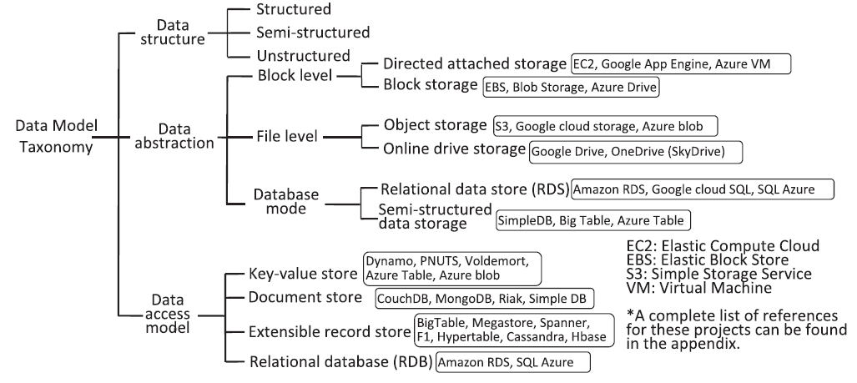
Storage models
Mansouri, Yaser, Adel Nadjaran Toosi, and Rajkumar Buyya. "Data storage management in cloud environments: Taxonomy, survey, and future directions." ACM Computing Surveys (CSUR) 50.6 (2017): 1-51.

Slide 18
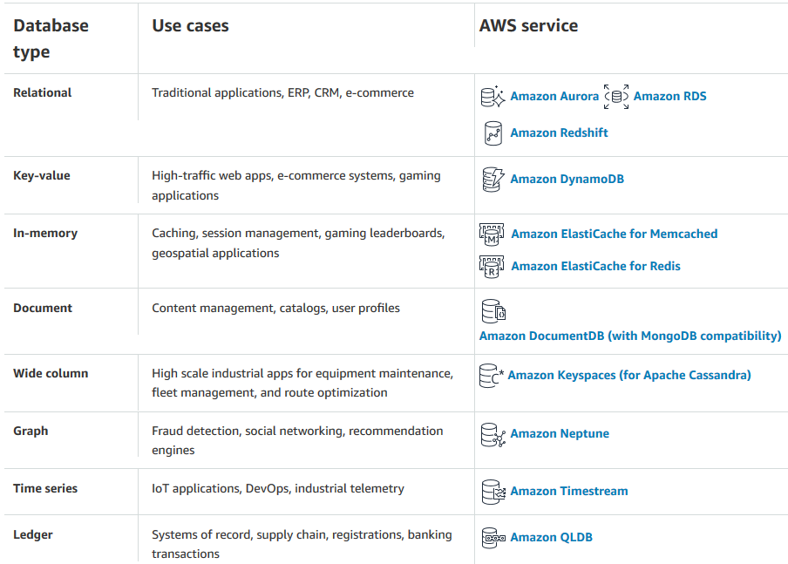
Storage models (AWS)
Data structure: structured
Data abstraction: database
Data access model: relational
Relational
Store data with predefined schemas and relationships between them
Support ACID transactions
Maintain referential integrity
https://aws.amazon.com/products/databases/

Slide 19
Storage models (AWS)
Data structure: unstructured
Data abstraction: database
Data access model: *
Key/value: store and retrieve large volumes of data
Document : store semi-structured data as JSON-like documents
Columnar: use tables but unlike a relational database, columns can vary from row to row in the same table
Graph: navigate and query relationships between highly connected datasets
... and more
https://aws.amazon.com/products/databases/

Slide 20
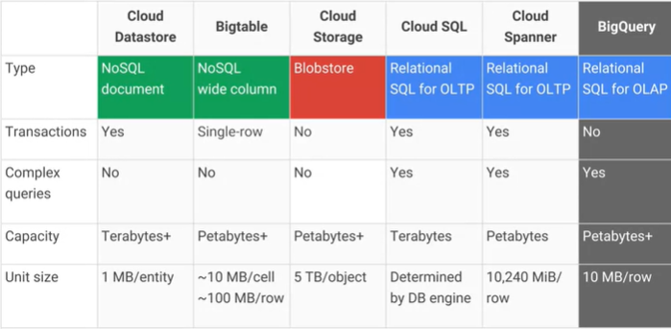
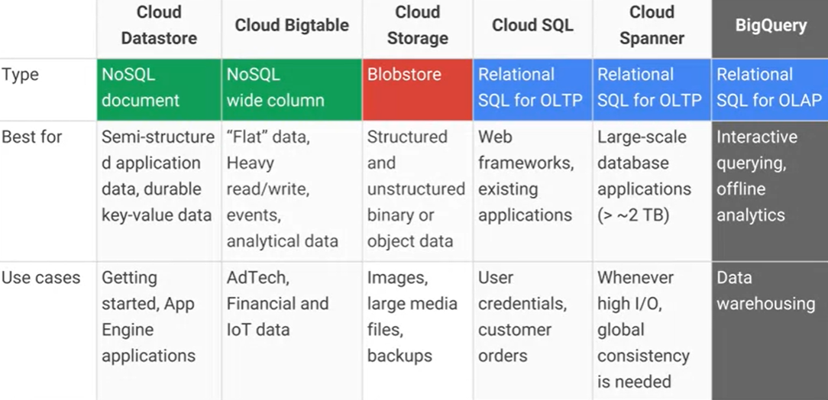
Storage models (Google Cloud)
https://cloud.google.com/products/databases

Slide 21
Storage models (AWS)
Data structure: unstructured
Data abstraction: file (or database)
Data access model: key-value
File system (EFS), object storage (S3) (or DB K-V; e.g., DynamoDB)
Handle unstructured data
... organized as files (or blob)
... accessed using a key-value
Differ in the supported features
E.g., maximum item size (DynamoDB: 400KB, S3: 5TB)
E.g., indexes, querying mechanisms, latency, etc.

Slide 22
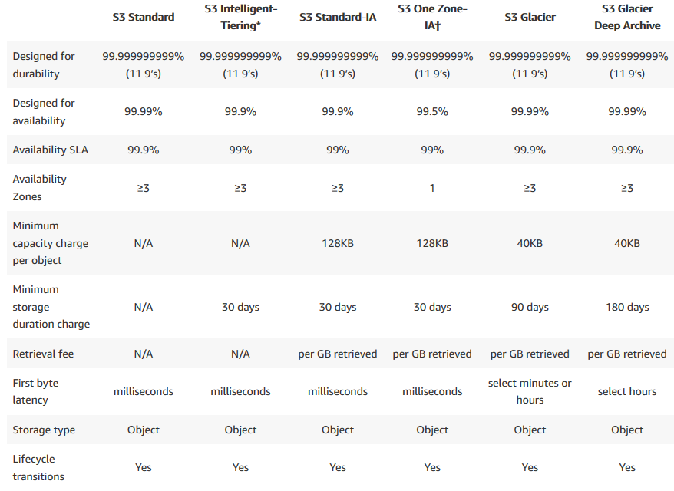
Storage: access frequency (AWS)
Object storage (AWS S3) classes
Standard: general purpose
Infrequent (rapid) access
One Zone-IA: lower-cost option for infrequently accessed data that do not require high availability and resilience
Glacier: low-cost storage class for data archiving, three retrieval options that range from a few minutes to hours
Deep Glacier: long-term retention for data accessed once or twice in a year. E.g., retain data sets for 10 years or longer
Intelligent-Tiering: move objects between access tiers when access patterns change
https://aws.amazon.com/s3/storage-classes/

Slide 23
Storage: access frequency (AWS)
Transition
Lifecycle configuration
A set of rules that define actions that Amazon S3 applies to a group of objects
Two types of actions:
Transition: when objects transition to another storage class. E.g., archive objects to the S3 Glacier storage class one year after creating them
Expiration: when objects expire. Amazon S3 deletes expired objects on your behalf
https://docs.aws.amazon.com/AmazonS3/latest/userguide/object-lifecycle-mgmt.html

Slide 24
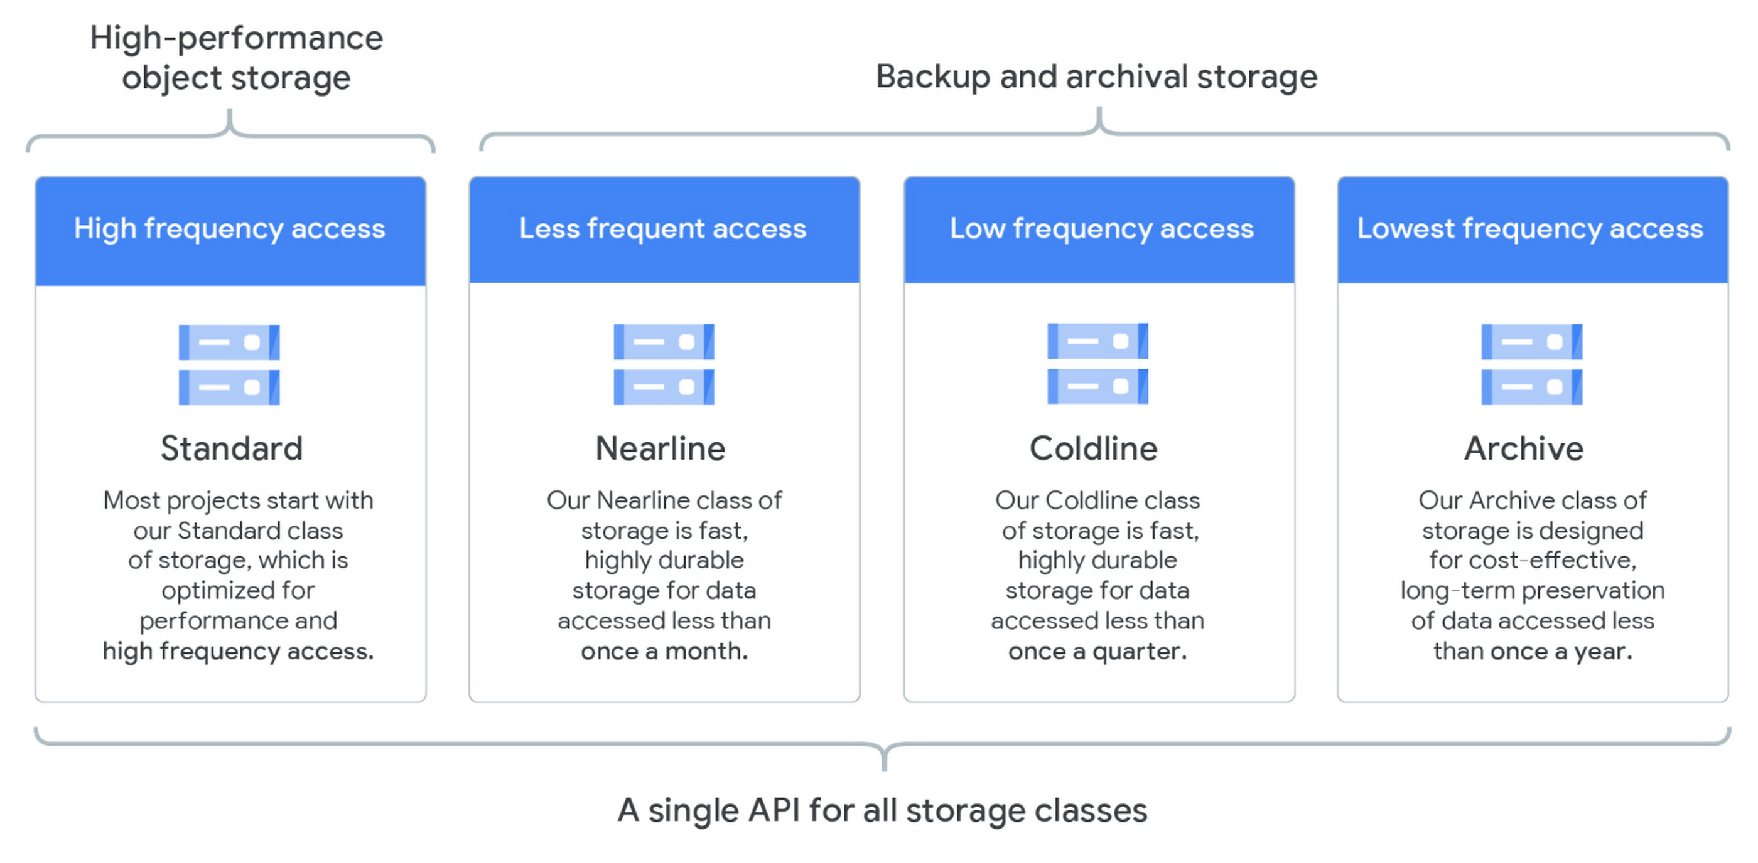
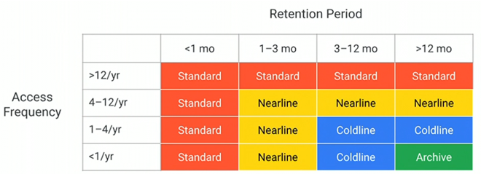
Storage: access frequency (Google Cloud)
https://cloud.google.com/blog/products/storage-data-transfer/archive-storage-class-for-coldest-data-now-available

Slide 25
A tentative organization
Data
transformation
Supporting services
Serve (deciding)
•
SQL
•
BI tools (e.g., Tableau)
Analytics (analyzing)
Storage
•
Processing
(organizing)
Security
•
File
•
Access Control
Networking, etc.
•
Batch
Computing
•
Streaming
•
Object
•
Authorization
•
Machine learning
•
DB
Ingestion (acquiring)
•
Batch
•
Streaming

Slide 26
Ingestion: bulk
Goal: moving data to the cloud
Moving data to the cloud
80TB of data to move,
1Gbps connection to the internet
How many days?

Slide 27
Ingestion: bulk
Goal: moving data to the cloud
Moving data to the cloud
80TB of data to move,
1Gbps connection to the internet
How many days?
80000GB / (1Gbps / 8) / 60 / 60 / 24 ~= a week without internet

Slide 28
Ingestion: bulk
Batch/Bulk: move data from on-premises storage
Workflow
Receive shipment
Set up
Transfer data
Ship back (shipping carrier)

Slide 29
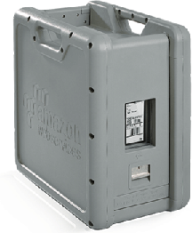
Ingestion: bulk (AWS)
AWS Snowball
50TB (North America only) and 80TB versions
Not rack-mountable
Throughput
1 Gbps or 10 Gbps using an RJ-45 connection
10 Gbps using a fiber optic connection
https://aws.amazon.com/snowball/

Slide 30
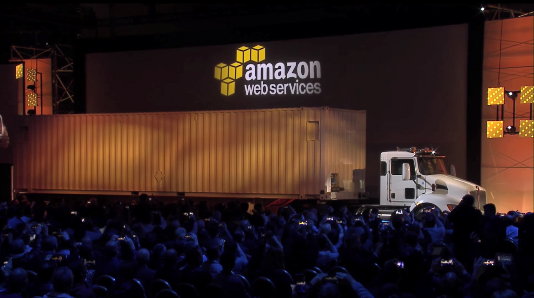
Ingestion

Slide 31

Ingestion: stream
Stream: real-time streaming data
Event: anything that we can observe occurring at a particular point in time
Continuous streaming
Illimited succession of individual events
Ordered by the point in time at which each event occurred
Publish/subscribe (pub/sub): a way of communicating messages
Senders publish messages associated with one or more topics
Receivers subscribe to specific topics, receive all messages with that topic
Messages are events
https://www.manning.com/books/event-streams-in-action

Slide 32
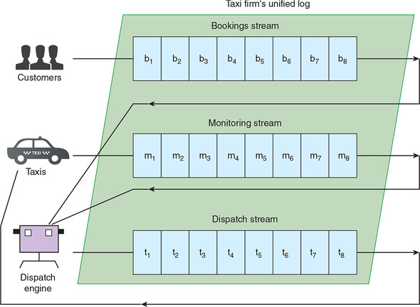
Ingestion: stream
General idea:
Collect events from many source systems
Store them in a unified log
Enable applications to operate on these event streams
Unified log
Unified, append-only, ordered, distributed log that allows the centralization of event streams

Slide 33
Ingestion: stream
Unified: a single log in a company with applications sending/reading events
Log serves as central data backbone
It can contain many distinct continuous streams of events
Not all events are sent to the same event stream
Append-only: new events are appended to the unified log
Existing events are never updated in place
If read the event #10, never look at events 1 through 10 again
Events are automatically deleted from the unified log when they age
E.g., automatically remove events after 7 days

Slide 34
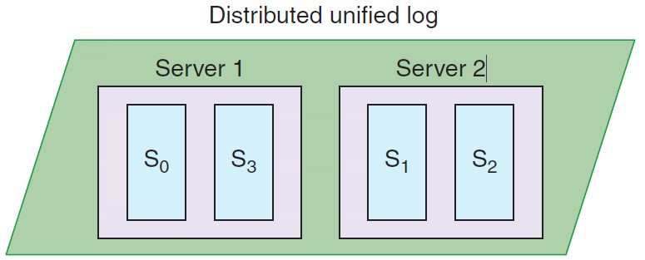
Ingestion: stream
Distributed: the unified log lives across a cluster of machines
Optionally divide events into shards (i.e., partitions) Still, the log is unified since we have a single (conceptual) log
Distribution ensures
Scalability: work with streams larger than the capacity of single machines
Durability: replicate all events within the cluster to overcome data loss

Slide 35
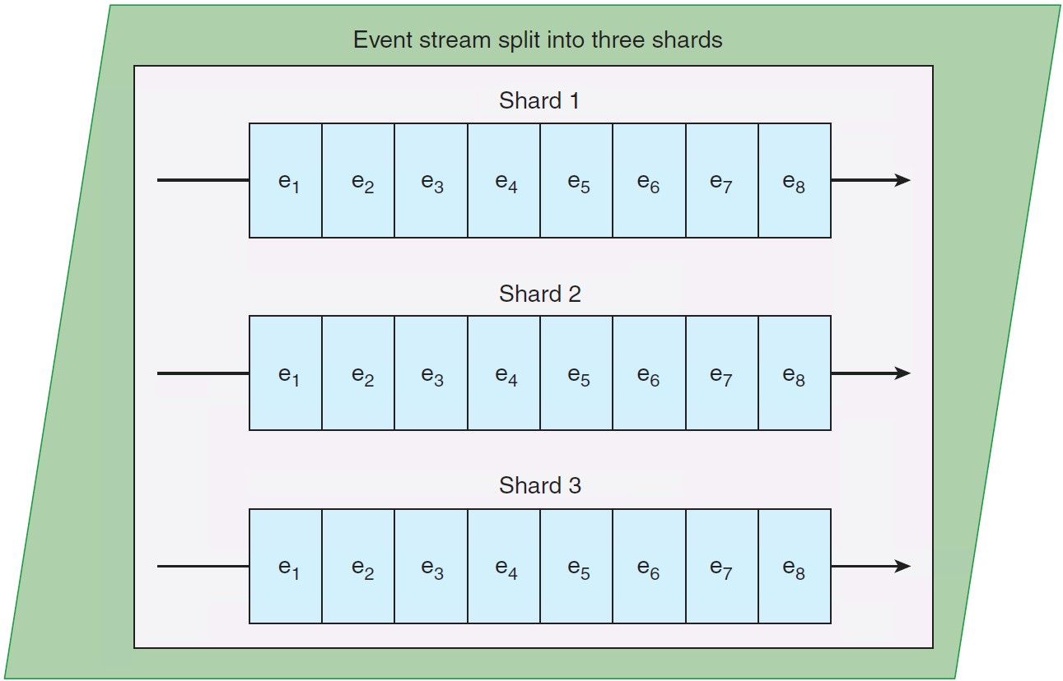
Ingestion: stream
Ordered: events in a shard have a sequential IDs (unique in a shard)
Local ordering keeps things much simpler than global ordering
Applications maintain their own cursor for each shard
Lamport, Leslie. "Time, clocks, and the ordering of events in a distributed system." Concurrency: the Works of Leslie Lamport. 2019. 179-196.

Slide 36
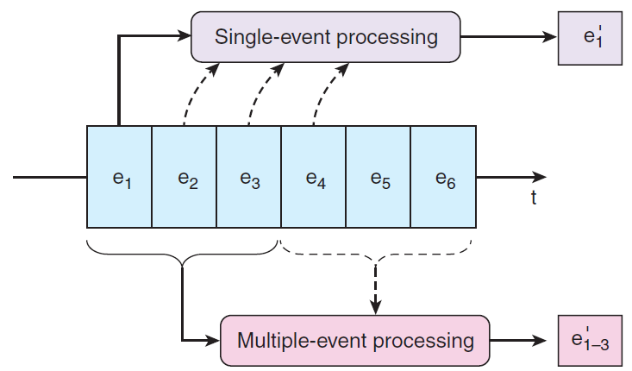
Ingestion: stream
Two types of processing
Single-event: a single event produces zero or more events
Validating “Does this event contain all the required fields?”
Enriching “Where is this IP address located?”
Filtering “Is this error critical?”
Multiple-event: multiple events collectively produce zero or more events
Aggregating, functions such as minimum, maximum, sum
Pattern matching, looking for patterns or co-occurence
Reordering events based on a sort key

Slide 37
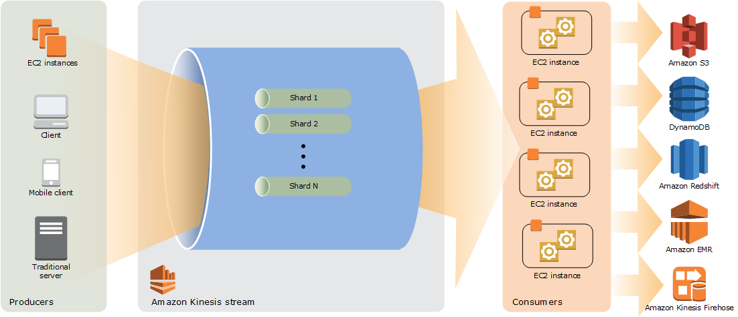
Ingestion: stream (AWS)
Amazon Kinesis Data Streams
Created and provisioned by shard
Each shard provides 1 MBps and 1000 data puts per second
A data record consists of
User-supplied partition key to balance records across shards
Incremental sequence number added by the shard
A data blob
Consumers get records by shard
Records are sorted by partition key and sequence number
Ordering is not guaranteed across shards
Records are retained for 7 days at maximum
https://docs.aws.amazon.com/streams/latest/dev/key-concepts.html

Slide 38
Ingestion: stream (AWS)
Resharding (i.e., scaling)
Split a shard into two, or merge two shards
Users must scale shards up and down manually
Monitor usage with Amazon CloudWatch and modify scale as needed
Avoid shard management by using Kinesis Data Firehose
Kinesis is a regional service, with streams scoped to specific regions
All ingested data must travel to the region in which the stream is defined
Costs
Priced by shard hour, data volume, and data retention period
Pay for resources you provision (even if not used)
https://aws.amazon.com/cloudwatch/ https://aws.amazon.com/kinesis/data-firehose

Slide 39
Ingestion: stream
Feature | AWS Kinesis | Google Pub/Sub
Unit of deployment | Stream | Topic
Unit of provisioning | Shard | N/A (fully managed)
Data unit | Record | Message
Data producer/destination | Producer/Consumer | Publisher/Subscriber
Data partitioning | User-supplied partition key | N/A (fully managed)
Retention period | Up to 7 days | Up to 7 days
Pricing | Per shard-hour, PUT payload units, and optional data retention | Message ingestion and delivery, and optional message retention

Slide 40
A tentative organization
Data
transformation
Supporting services
Serve (deciding)
•
SQL
•
BI tools (e.g., Tableau)
Analytics (analyzing)
Storage
•
Processing
(organizing)
Security
•
File
•
Access Control
Networking, etc.
•
Batch
Computing
•
Streaming
•
Object
•
Authorization
•
Machine learning
•
DB
Ingestion (acquiring)
•
Batch
•
Streaming

Slide 41
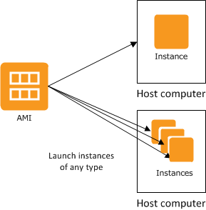
Single instance: AWS EC2
Amazon Elastic Compute Cloud
A web service that provides resizable compute capacity
Complete control of computing resources
Processor, storage, networking, operating system, and purchase model
Amazon Machine Image is a template of a software configuration
E.g., an operating system, an application server, and applications
From an AMI, you launch (multiple) instances running as a virtual servers
https://aws.amazon.com/ec2/ https://docs.aws.amazon.com/AWSEC2/latest/UserGuide/compute-optimized-instances.html (example of AMI)

Slide 42
Single instance: AWS EC2
An instance type determines the hardware of the host computer
Each instance type offers different compute and memory capabilities
After launch, you can interact with it as you would with any computer
You have complete control of your instances
E.g., `sudo` to run commands
https://aws.amazon.com/ec2/instance-types/

Slide 43
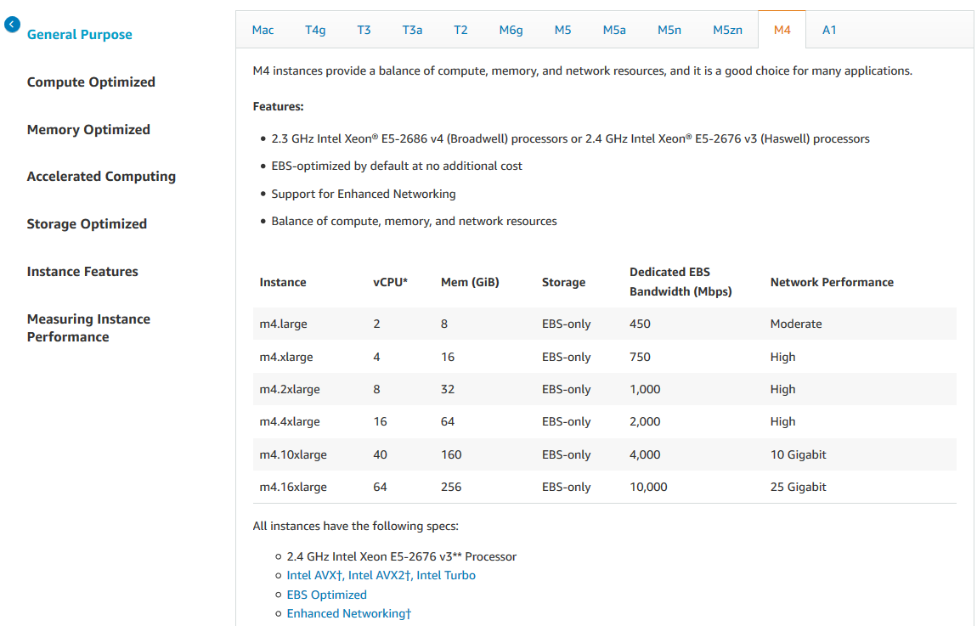
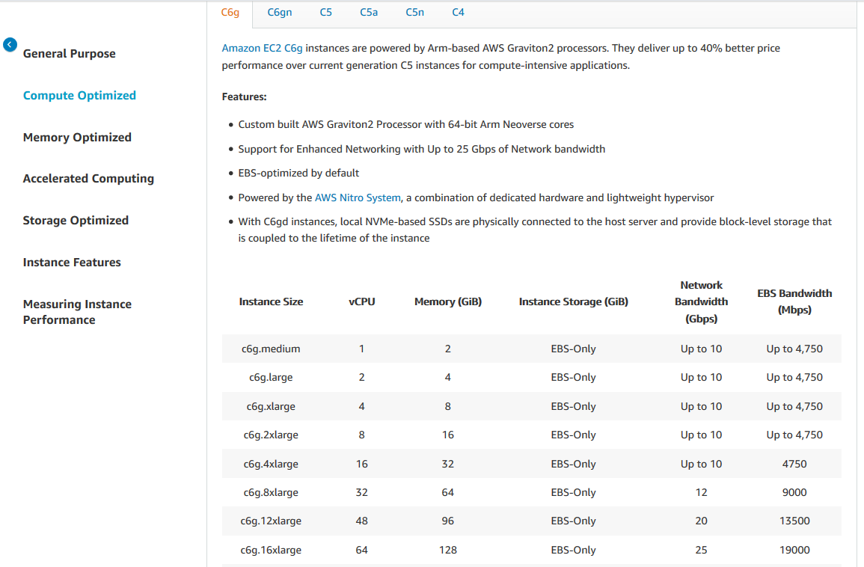
Single instance: AWS EC2
https://aws.amazon.com/ec2/instance-types/

Slide 44
Cluster: AWS EMR
Amazon EMR is a data platform based on the Hadoop stack
Apache Spark, Apache Hive, Apache HBase, etc.
You can run workloads on
Amazon EC2 instances
Amazon Elastic Kubernetes Service (EKS) clusters
On-premises using EMR on AWS Outposts
Example of workload
Upload input data into Amazon S3
EMR launches EC2 instances that you specified
EMR begins the execution while pulling the input data from S3 into the launched instances
Once the cluster is finished, EMR transfers output data to Amazon S3

Slide 45
A tentative organization
Data
transformation
Supporting services
Serve (deciding)
•
SQL
•
BI tools (e.g., Tableau)
Analytics (analyzing)
Storage
•
Processing
(organizing)
Security
•
File
•
Access Control
Networking, etc.
•
Batch
Computing
•
Streaming
•
Object
•
Authorization
•
Machine learning
•
DB
Ingestion (acquiring)
•
Batch
•
Streaming

Slide 46
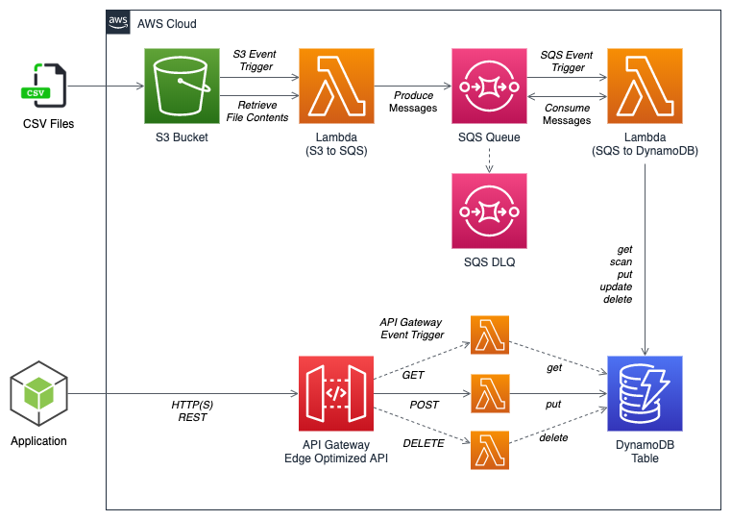
Serverless computing/processing
AWS Lambda: compose code functions in a loose orchestration
Build modular back-end systems
Event-driven and push-based pipelines
With Lambda, you are responsible only for your code (i.e., a Lambda function)
Lambda manages the compute fleet that offers a balance of memory and CPU
Lambda performs operational and administrative activities on your behalf
Provisioning capacity, monitoring fleet health, applying security patches, deploying your code

Slide 47
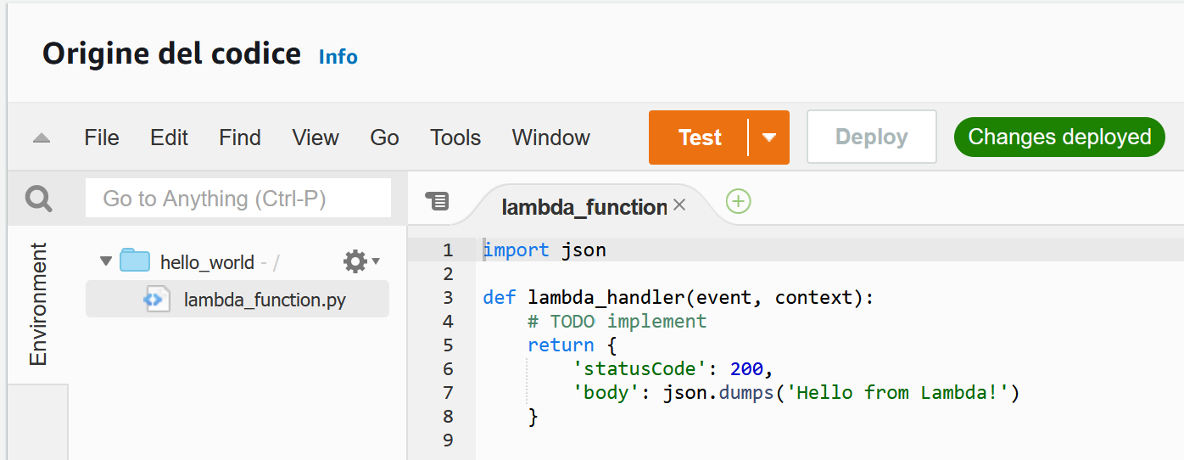
Serverless computing (AWS Lambda)
AWS Lambda
A Lambda function is a granular service
The Lambda runtime invokes a lambda function multiple times in parallel
Compute service that executes code written in JavaScript/Python/C#/Java
Elastic Compute Cloud (EC2) servers run the code (e.g., a Linux server)
A function is `code + configuration + dependencies`
Source code (JARs or DLLs) is zipped up and deployed to a container
Invocation supports push/pull events

Slide 48
Serverless computing (FaaS)
FaaS: write single-purpose stateless functions
Keep the single responsibility principle in mind
A function that does just one thing is more testable and robust
A function with a well-defined interface is also more likely to be reused
Code should be created in a stateless style
Statelessness allows scalability
Local resources or processes will not survive along sessions
Functions that terminate sooner are cheaper
E.g., pricing is based on #requests, execution time, and allocated memory

Slide 49

Patterns for data pipelines
Patterns are architectural solutions to problems in software design
A (design) pattern is a general, best-practice reusable solution to a commonly occurring problem within a given context in software design
It is a template for how to solve a problem in many different situations
Patterns for serverless data pipelines
Command pattern
Messaging pattern
Priority queue pattern
Pipes and filters pattern
https://www.manning.com/books/aws-lambda-in-action

Slide 50
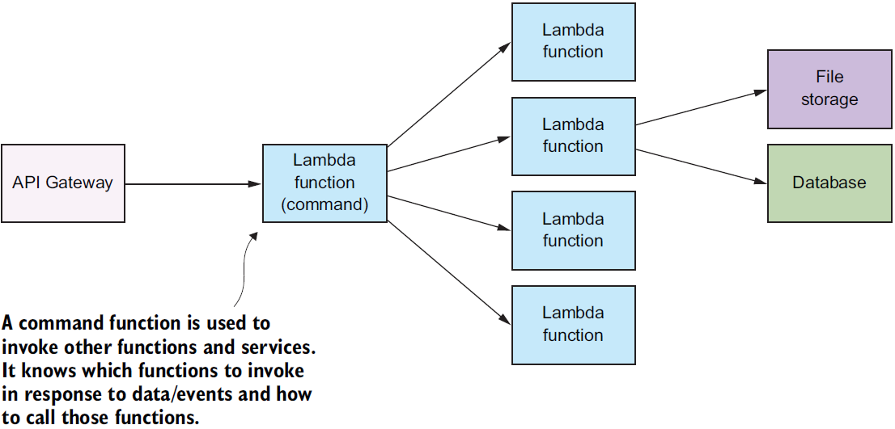
Command pattern
Command pattern
A behavioral design pattern in which an object is used to encapsulate the information needed to perform an action or trigger an event
Encapsulate a request as an object
Issue requests to objects without knowing anything about the operation being requested or the receiver
https://aws.amazon.com/api-gateway

Slide 51
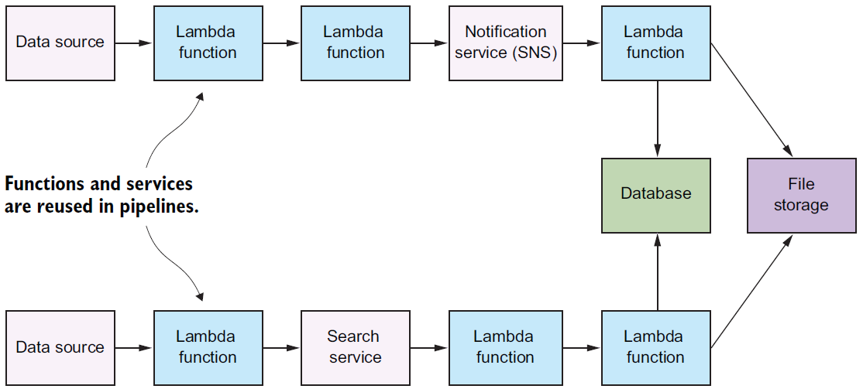
Pipes and filters pattern
Decompose a complex processing task into a sequence of manageable services
Components designed to transform data are referred to as filters
Connectors that pass data between components are referred to as pipes

Slide 52
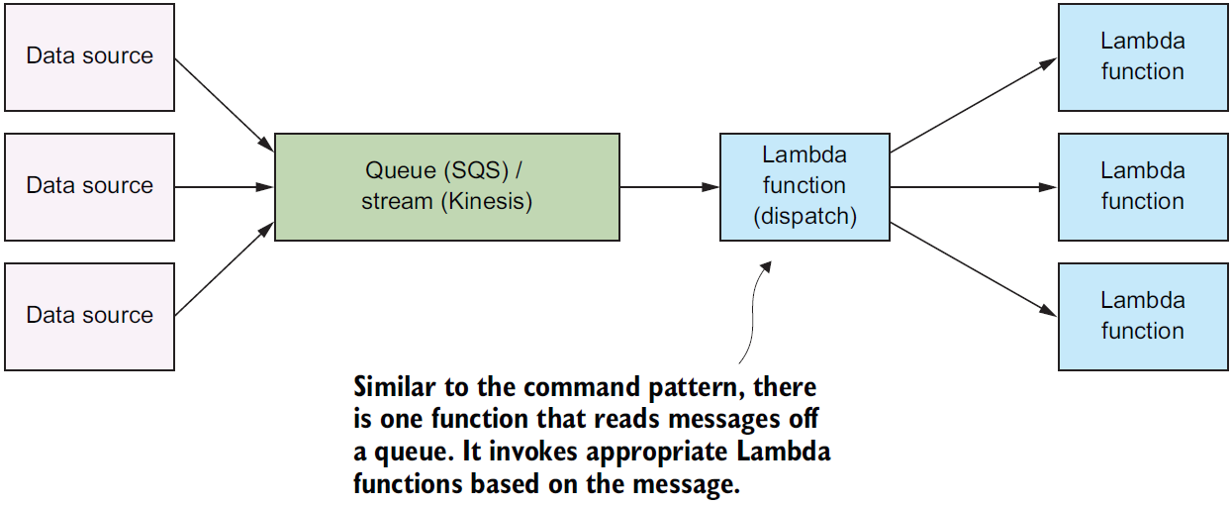
Messaging pattern
Messaging pattern
Describes how two different parts of a message passing system connect and communicate with each other
Decouple services from direct dependence and allow storage of events in a queue
Reliability: if the consuming service goes offline, messages are retained in the queue and can still be processed
A message queue can have a single sender/receiver or multiple senders/receivers

Slide 53
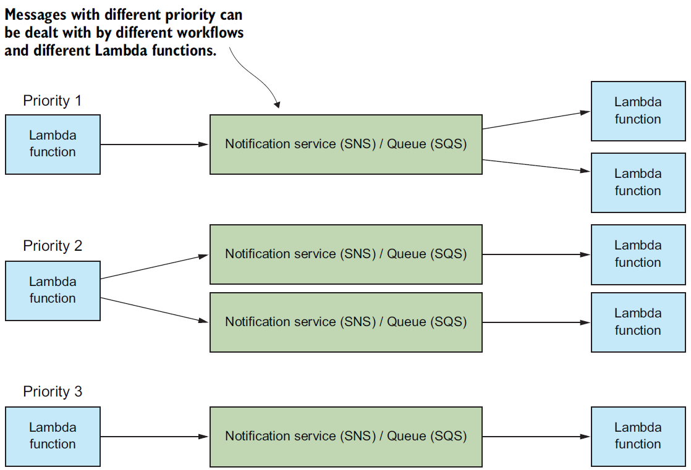
Priority queue pattern
Decouple and prioritize requests sent to services
Requests with a higher priority are received and processed more quickly than those with a lower priority
Useful in applications that offer different service level guarantees
Control how and when messages are dealt with
Different queues, topics, or streams to feed messages to your functions
High-priority messages go through expensive services with more capacity

